Slide 1

SQL
FINAL PROJECT
Topic- IPL auction strategy

Slide 2
01
. Batsman
Types of Batsman:-
Aggressive batsman
Anchor batsman
Hard Hitting players
02
Bowlers
Types of bowlers:-
With Good Economy
With Best Strike
03
All Rounders
04
Wicketkeepers

Slide 3
Link for SQL file-fp2.sql
Queries

Slide 4
Initial queries set datestyle='DMY'; create table matches (id int,city varchar,date date,player_of_match varchar, venue varchar,neutral_venue varchar,team1 varchar, team2 varchar,toss_winner varchar,toss_decision varchar, winner varchar,result varchar,result_margin varchar, eliminator varchar,method varchar,umpire1 varchar,umpire2 varchar); copy matches from 'C:\Program Files\PostgreSQL\12\IPL Dataset\IPL_matches.csv' delimiter ',' csv header; select * from matches; Create table Balls(id int,inning int,over int, ball int,batsman varchar, non_striker varchar , bowler varchar,batsman_runs int , extra_runs int, total_runs int, is_wicket int, dismissal_kind varchar, player_dismisssed varchar, fielder varchar, extras_type varchar, batting_team varchar, bowling_team varchar); copy Balls from 'C:\Program Files\PostgreSQL\12\IPL Dataset\IPL_Ball.csv' delimiter ',' csv header; select * from Balls;

Slide 5
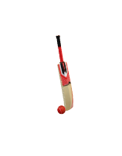
Aggressive Batsman

Slide 6
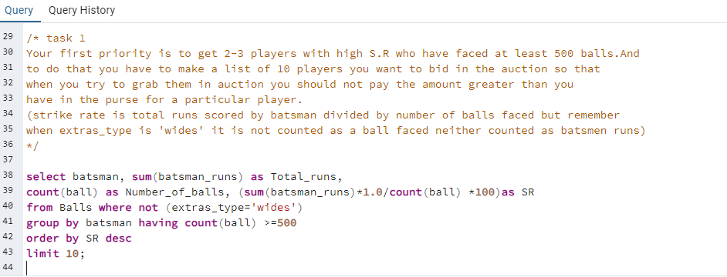
QUERY

Slide 7
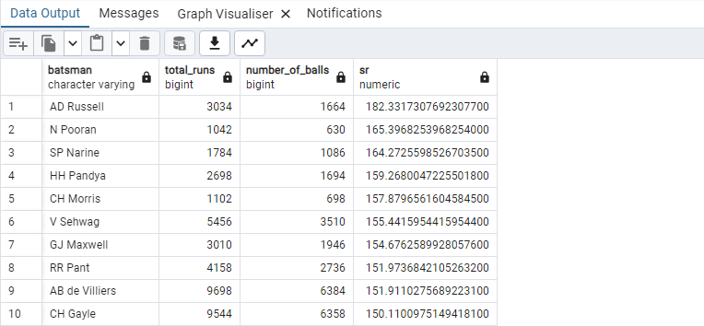
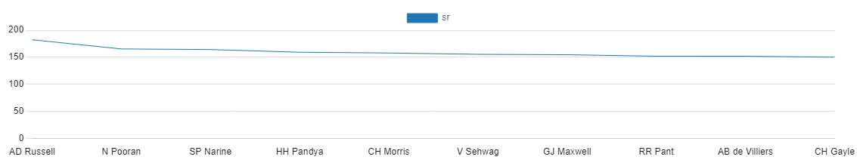
OUTPUT
OUTPUT

Slide 8
Anchor Batsman

Slide 9
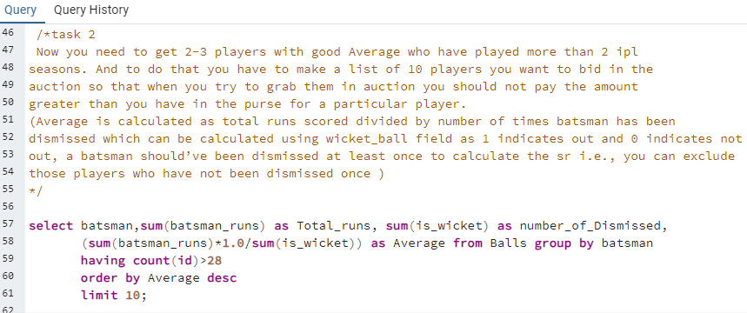
QUERY

Slide 10
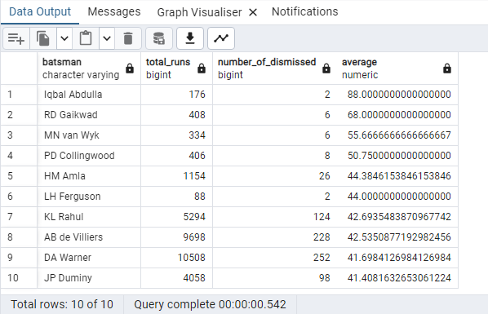
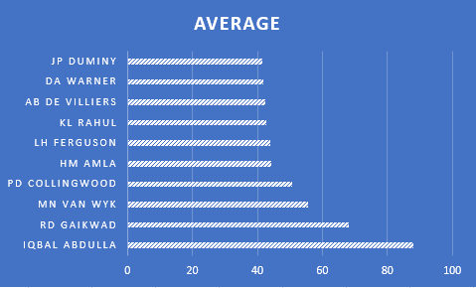
OUTPUT

Slide 11
Hard Hitting Players

Slide 12
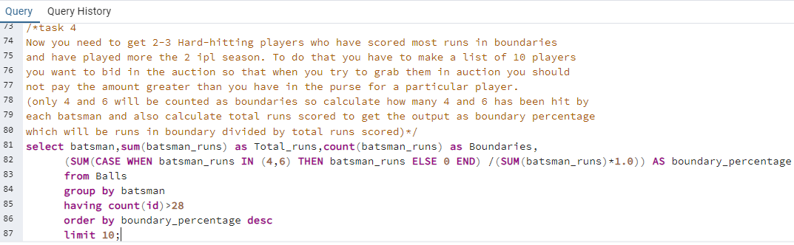
QUERY

Slide 13
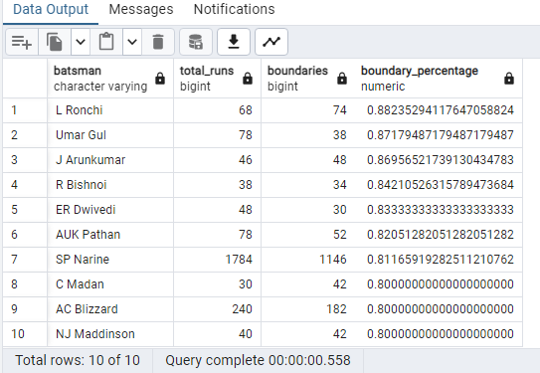
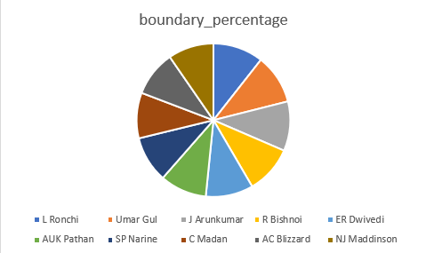
OUTPUT

Slide 14
Bowlers with good economy

Slide 15
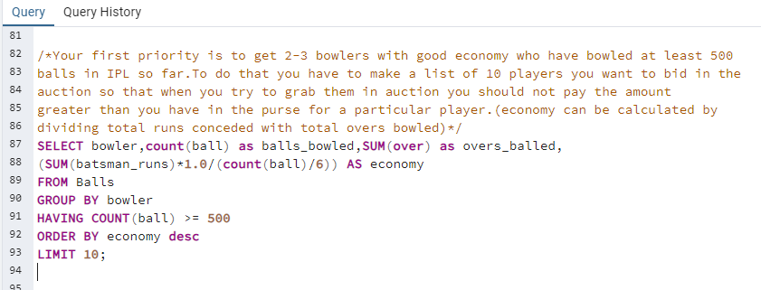
QUERY

Slide 16
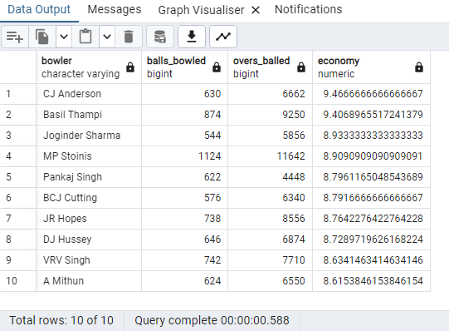
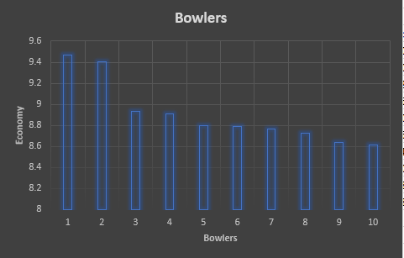
OUTPUT
OUTPUT

Slide 17
Bowlers with Best Strike Rate

Slide 18
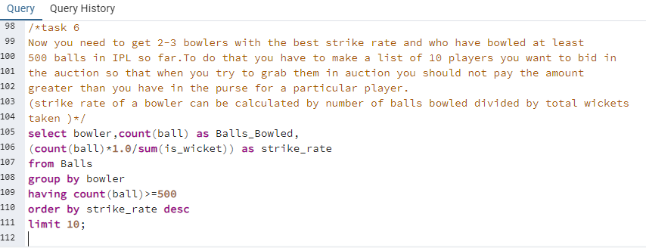
QUERY

Slide 19
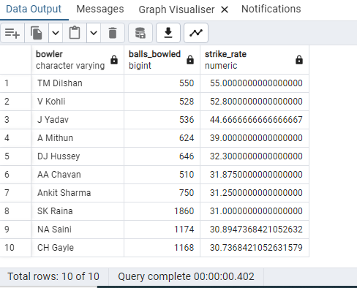
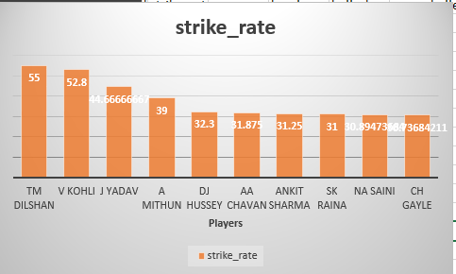
OUTPUT

Slide 20
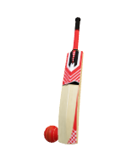
All Rounders
Now you need to get 2-3 All_rounders with the best batting as well as bowling strike rate and who have faced at least 500 balls in IPL so far and have bowled minimum 300 balls.To do that you have to make a list of 10 players you want to bid in the auction so that when you try to grab them in auction you should not pay the amount greater than you have in the purse for a particular player. ( strike rate of an all rounder can be calculated using the same criteria of batsman similarly the bowling strike rate can be calculated using the criteria of a bowler

Slide 21
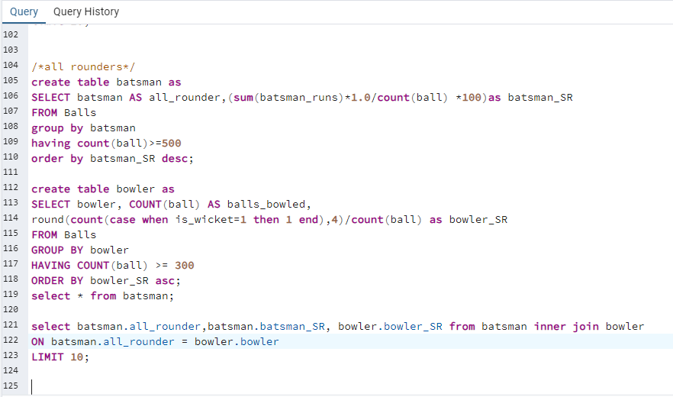
QUERY

Slide 22
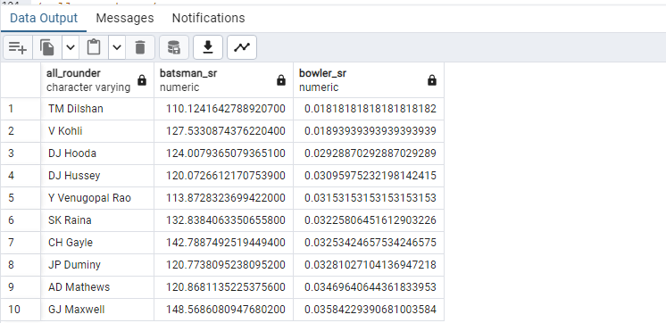
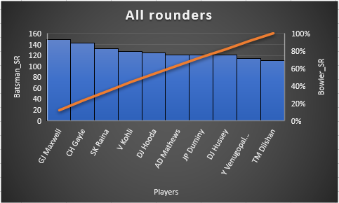
OUTPUT

Slide 23
Wicket Keepers
Criteria for choosing wicket-keepers from the list-
Those players who have taken most wickets and have played in atleast two seasons also number of no balls should also be less than other players and have given less runs to a team.

Slide 24
List of players for a good winning team ,2 players from every category based on analysis and queries performed:- Aggressive batsman-AD Russell, N Pooran Anchor batsman-Iqbal Abdulla,RD Gaikwad Hard Hitting players-L Ronchi,Umar Gul Bowlers with good econ0my-VRV singh, A Mithun(lower economy,better player) Bowlers with best Strike rate- NA Saini, CH Gayle(lower strike rate,better player) All Rounders-TM Dilshan, V Kohli

Slide 25
ADDITIONAL QUESTIONS

Slide 26
(Deliveries is the table created using the IPL_Ball data whereas the Matches table has been created using the IPL_Matches data)MENTIONED IN PROJECT
Create table Deliveries(id int,inning int,over int,ball int,batsman varchar, non_striker varchar , bowler varchar,batsman_runs int , extra_runs int, total_runs int, is_wicket int, dismissal_kind varchar, player_dismisssed varchar, fielder varchar,extras_type varchar, batting_team varchar, bowling_team varchar);
copy Deliveries from 'C:\Program Files\PostgreSQL\12\IPL Dataset\IPL_Ball.csv'
delimiter ','csv header;
select * from Deliveries;
(CREATED AT STARTING ,JUST PROVIDING THE QUERY AGAIN)
create table matches (id int,city varchar,date date,player_of_match varchar, venue varchar,neutral_venue varchar,team1 varchar, team2 varchar,toss_winner varchar,toss_decision varchar, winner varchar,result varchar,result_margin varchar, eliminator varchar,method varchar,umpire1 varchar,umpire2 varchar); copy matches from 'C:\Program Files\PostgreSQL\12\IPL Dataset\IPL_matches.csv' delimiter ',' csv header; select * from matches;

Slide 27
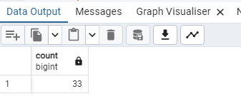
Ques 1 . Get the count of cities that have hosted an IPL match
Query->
SELECT COUNT(DISTINCT city)
FROM Matches;

Slide 28
Ques2. Create table deliveries_v02 with all the columns of the table ‘deliveries’ and an additional column ball_result containing values boundary, dot or other depending on the total_run(boundary for >= 4, dot for 0 and other for any other number) (Hint 1 : CASE WHEN statement is used to get condition based results) (Hint 2: To convert the output data of the select statement into a table, you can use a subquery. Create table table_name as [entire select statement].
QUERY->
Create table deliveries_v02 as
select *,CASE WHEN total_runs >= 4 THEN 'boundary'
WHEN total_runs = 0 THEN 'dot'ELSE 'other'END AS ball_result
from Deliveries;
select * from deliveries_v02;

Slide 29
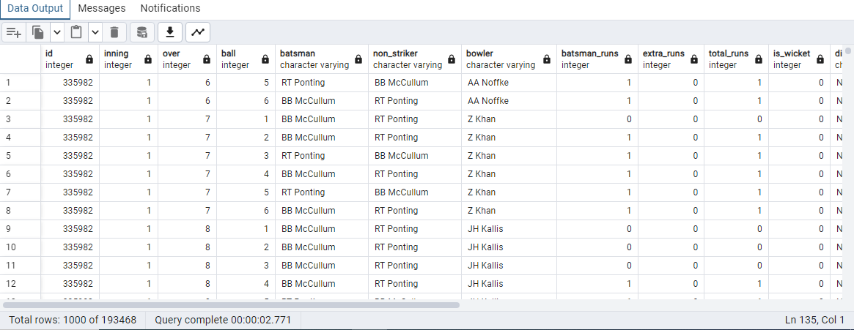
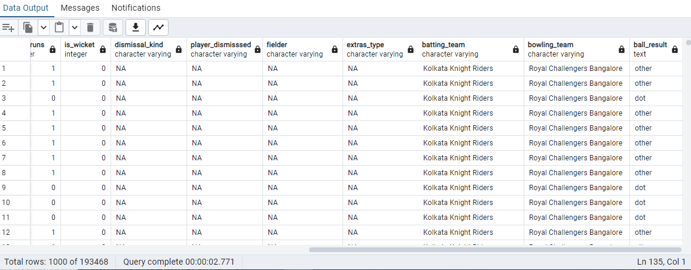

Slide 30
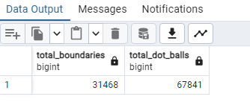
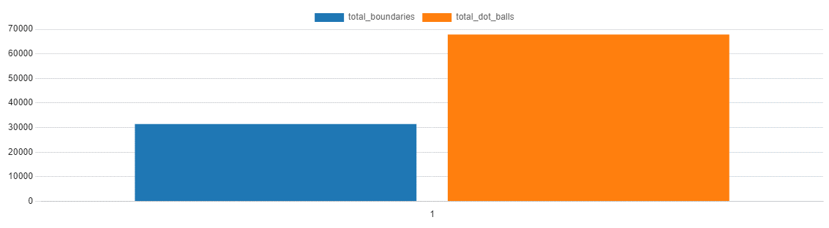
Ques 3. Write a query to fetch the total number of boundaries and dot balls from the deliveries_v02 table.
Query->
SELECT
SUM(CASE WHEN ball_result = 'boundary' THEN 1 ELSE 0 END) AS total_boundaries,
SUM(CASE WHEN ball_result = 'dot' THEN 1 ELSE 0 END) AS total_dot_balls
FROM deliveries_v02;

Slide 31
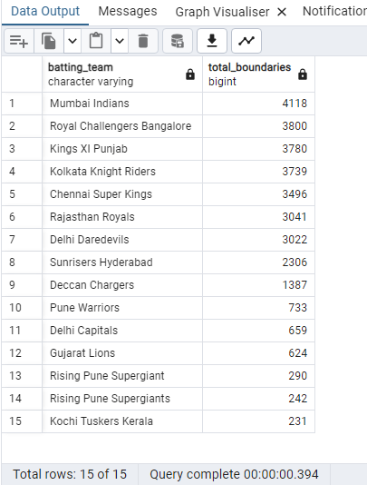
Ques4. Write a query to fetch the total number of boundaries scored by each team from the deliveries_v02 table and order it in descending order of the number of boundaries scored.
QUERY->
SELECT DISTINCT
batting_team,
SUM(CASE WHEN ball_result = 'boundary' THEN 1 ELSE 0 END) AS total_boundaries
FROM deliveries_v02
GROUP BY batting_team
ORDER BY total_boundaries DESC;

Slide 32
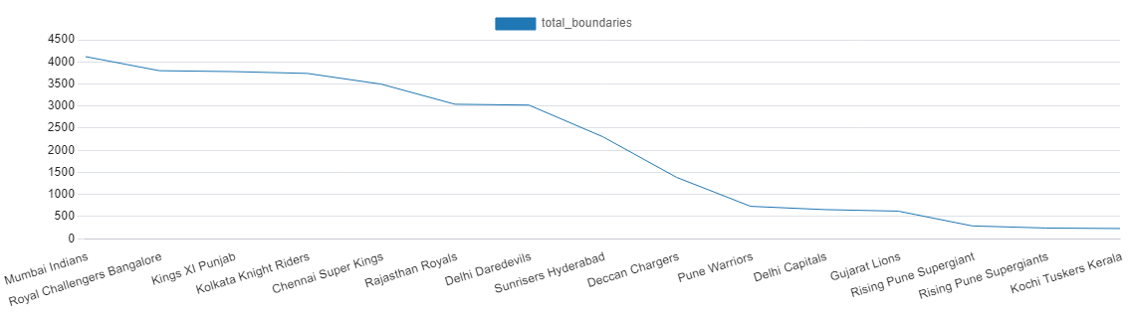
Visualization

Slide 33
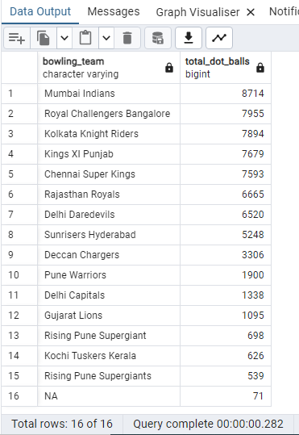
Ques5. Write a query to fetch the total number of dot balls bowled by each team and order it in descending order of the total number of dot balls bowled.
QUERY->
SELECT
bowling_team,
SUM(CASE WHEN ball_result = 'dot' THEN 1 ELSE 0 END) AS total_dot_balls
FROM deliveries_v02
GROUP BY bowling_team
ORDER BY total_dot_balls DESC;

Slide 34
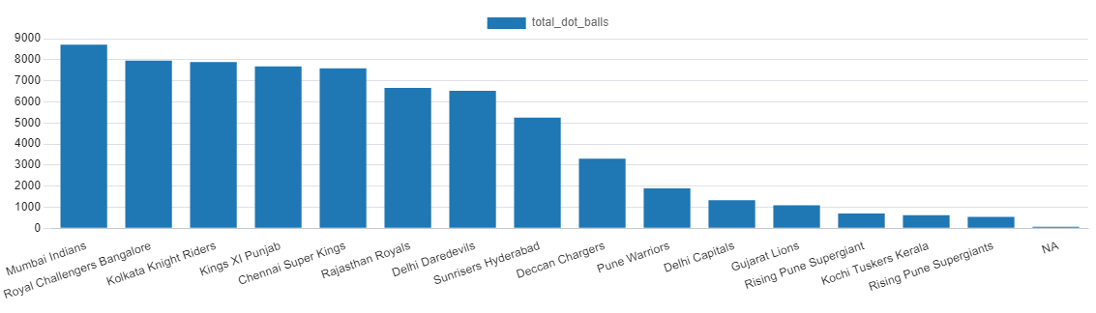
Visualization

Slide 35
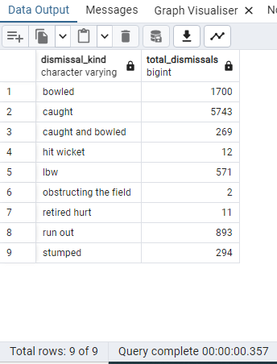
Ques 6. Write a query to fetch the total number of dismissals by dismissal kinds where dismissal kind is not NA
Query->
SELECT
dismissal_kind,
COUNT(*) AS total_dismissals
FROM deliveries_v02
WHERE NOT dismissal_kind='NA'
GROUP BY dismissal_kind;

Slide 36
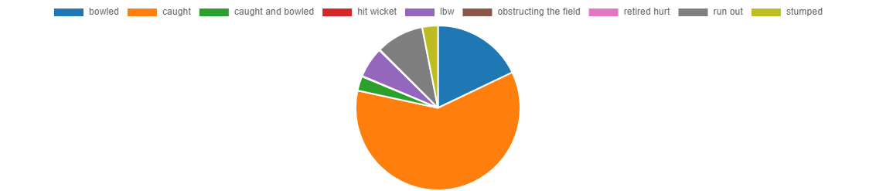
Visualization

Slide 37
Ques7. Write a query to get the top 5 bowlers who conceded maximum extra runs from the deliveries table
Query->
SELECT
bowler,
SUM(CASE WHEN extra_runs > 0 THEN extra_runs ELSE 0 END) AS total_extra_runs
FROM deliveries
GROUP BY bowler
ORDER BY total_extra_runs DESC
LIMIT 5;

Slide 38
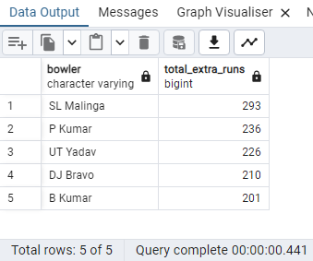
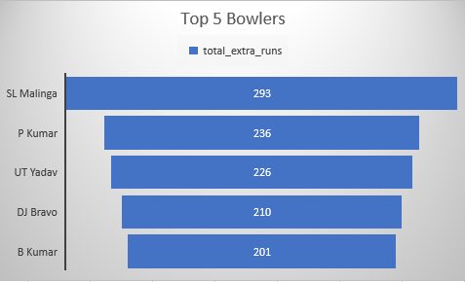

Slide 39
Ques8. Write a query to create a table named deliveries_v03 with all the columns of deliveries_v02 table and two additional column (named venue and match_date) of venue and date from table matches.
Query->
CREATE TABLE deliveries_v03 AS
SELECT
a.*,
b.venue,
b.date AS match_date
FROM deliveries_v02 as a
LEFT JOIN matches as b ON a.id = b.id;
select * from deliveries_v03;

Slide 40
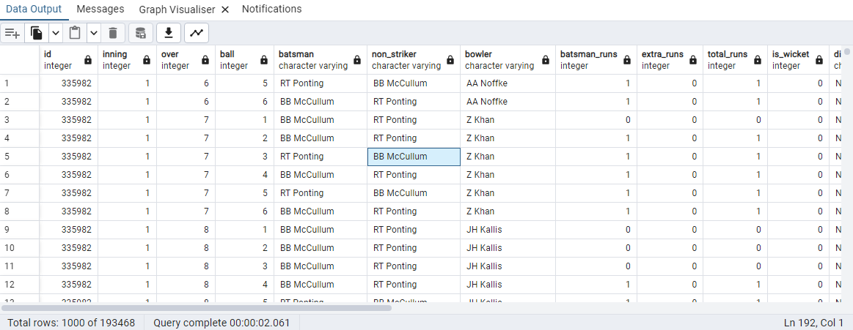
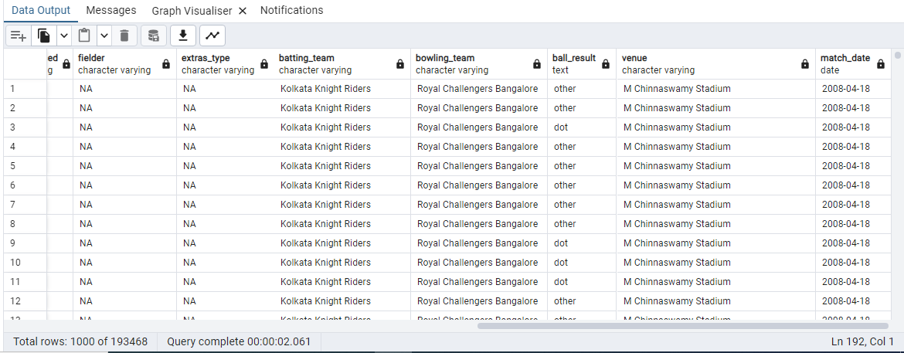

Slide 41
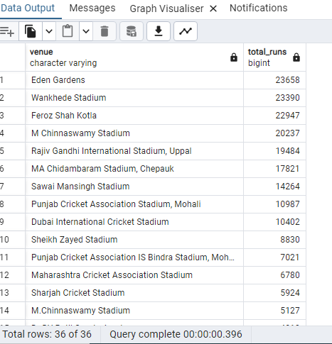
Ques 9. Write a query to fetch the total runs scored for each venue and order it in the descending order of total runs scored.
Query->
SELECT
venue,
SUM(total_runs) AS total_runs
FROM deliveries_v03
GROUP BY venue
ORDER BY total_runs DESC;

Slide 42
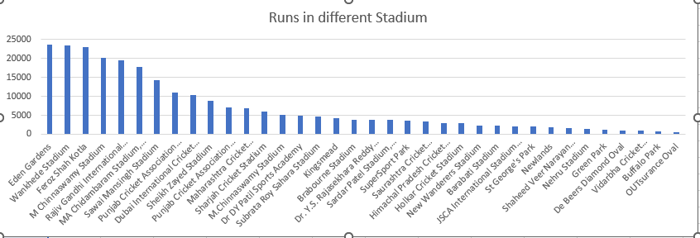

Slide 43
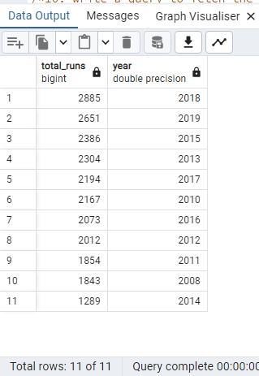
Ques10. Write a query to fetch the year-wise total runs scored at Eden Gardens and order it in the descending order of total runs scored.
Query->
SELECT
SUM(total_runs) AS total_runs,
extract(year from match_date) AS year
FROM deliveries_v03
WHERE venue = 'Eden Gardens'
GROUP BY year
ORDER BY year asc;

Slide 44
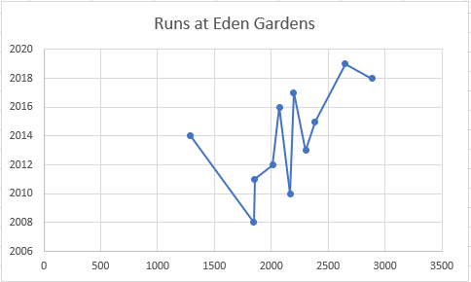

Slide 45

NAME-PALAK GOEL
BATCH- 15 FEB
COURSE- DATA SCIENCE
PROJECT-SQL FINAL PROJECT

